Slide 1
Entity Names
October 24, 2014
Notes:
Guidewire training materials contain Guidewire proprietary information that is subject to confidentiality and non-disclosure agreements. You agree to use the information in this manual solely for the purpose of training to implement Guidewire software solutions. You also agree not to disclose the information in this manual to third parties or copy this manual without prior written consent from Guidewire. Guidewire training may be given only by Guidewire employees or certified Guidewire partners under the appropriate agreement with Guidewire.

Slide 2
Describe the role of entity names in Guidewire applications
Distinguish between the entity name file and entity name types
Create and modify entity names using the Entity Name editor
Reference entity name types

Slide 3
Entity name files and entity name types
Create and configure entity name types
Reference entity name types

Slide 4
Entity name
An entity name defines how to display a name for an instance of a given entity
An entity name file contains at least one default entity name type definition
Default definition always accessible with the entity DisplayName property
anAddress.DisplayName
anABCompany.DisplayName
anABContact.DisplayName
aContactNote.DisplayName
aEFTDate.DisplayName
Notes:
All entity instances have a DisplayName property. The DisplayName property returns a string for an entity instance.
It is possible to configure how the DisplayName property returns a string value for a given entity. If an existing entity name type definition exists, you can modify the Gosu code that creates a return string value for the default DisplayName property. Otherwise, if no entity name type definition exists, you can create a new entity name file for a given entity. In the new entity name file, you can define the default for the entity name type definition with Gosu code that creates a return string value for the default DisplayName property.
In certain cases, the base configuration of a Guidewire application, an entity name file may have more than one entity name type definition. You can modify (but not delete) any base configuration entity name type definition. In addition, it is possible to define more than on entity name type definition in an entity name file.
Guidewire applications use entity name type definitions to return limited information from the Guidewire database about how to construct the string. The practice helps application performance because there is no need to retrieve all the fields for an entity and possibly the subentities.

Slide 5
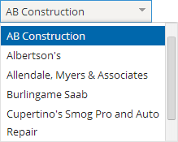
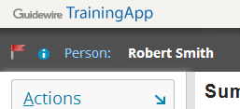
Entity names usage
When displaying an entity instance
Example:
Drop-down list of contacts
When explicitly referencing the DisplayName property of an entity instance
Example:
Value property of InfoBarElement defined as anABContact.DisplayName

Slide 6
Complex entity name types
1 uses gw.api.privacy.EncryptionMaskExpressions
… 3 var sb = new java.lang.StringBuffer()
4 if (IsPrimary) {
5 sb.append("* ")
6 }
…8 if (BankName != null and BankName.length() > 0) {
9 sb.append(BankName)
10 }
…12 if (BankAccountNumber != null and BankAccountNumber.length() > 0) {
13 if (sb.length() > 0) {
14 sb.append(", ")
15 }
16 sb.append(EncryptionMaskExpressions .maskBankAccountNumber(BankAccountNumber))
17 }
…19 return sb.toString()
Example of the default entity name type for EFTData.en
Conditional logic, string manipulation, and calculations are common uses for complex entity names types
Notes:
Because entity name types are defined in Gosu, entity name types often perform one or more of the following operations:
Conditional logic, such as a display name for ABPerson that appends the middle name field only if it is not null or an activity display name that uses "Open: " plus the subject for open activities and "Closed: " plus the subject for closed activities.
String manipulation, such as a display name for order numbers that converts the value to all capital letters, or a display name for credit card numbers that uses just the last four digits.
Calculations, such as a display name for ABCompany that appends the number of employees at the end of the name.
In the slide example, EFTData.en is an entity name file for the EFTData entity. Electronic funds transfer or EFT refers to the computer-based systems used to perform financial transactions electronically. The default entity name type uses an Guidewire API to mask (line 16) all but the last three digits of a given bank account number (if the number has four digits or less, the entire account number is masked.

Slide 7
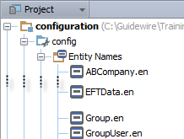
Undefined entity name
Using the DisplayName property for an entity without an entity name type definition results in a list of fields
Example:
aFlagEntry.DisplayName
No FlagEntry.en file
(FlagEntry) {ID=56, BeanVersion=0, ABContact=94, CreateTime=Mon Jan 13 14:54:46 PST 2014, CreateUser=3, FlagDate=Mon Jan 13 14:54:46 PST 2014, IsOpen=true, LoadCommandID=null, PublicID=ab:56, Reason=No email address for this contact., Resolution=null, RetiredValue=0, UnflagDate=null, UnflagUser=null, UpdateTime=Mon Jan 13 14:54:46 PST 2014, UpdateUser=3}
Notes:
The base configuration of a Guidewire application provides entity names only for primary entities. You can create entity names for entities that do not have defined entity names. For custom entities added to the data model, consider creating entity names if the name of the entity is displayed in the user interface.

Slide 8
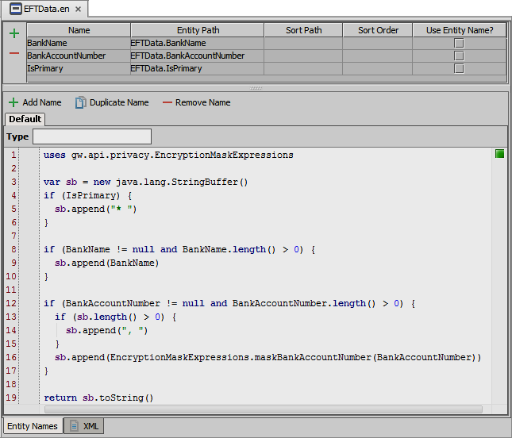
Entity Name editor
Edit the Default name and internally defined names
/displaynames/
EN files
Create custom entity names
Consists of
Variable table editor
Return value pane
View file as XML
Define return values with Gosu code
Changes require application restart
Notes:
Guidewire applications use the DisplayName property of an entity to represent the entity as a string. Guidewire applications use the entity name type definitions in generating database queries that return the limited information needed to construct the display name string.
With entity names, you can avoid loading the complete entity instance into memory. The use of entity names improves overall application performance.
The Entity Name editor consists of two parts: a table to define and edit variables for entity properties and a return value pane that defines the return string for the given entity name. In the return value pane, a Gosu code expression often references the table variables. You can define an entity name string as a simple text string or write a Gosu expression to generate the string.
With the Entity Name editor, it is possible to view, but not edit, the raw XML.

Slide 9
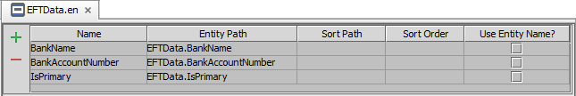
Entity Name editor: Variable table
Create, edit and delete variables
Define variable with:
Name of the variable
Entity path as the entity property that is a data column
Sort Path defines the sort values in the application sort
Sort Order defines the order of the Sort Paths
Use the Entity Name? for when entity path is an entity (foreign key)
Notes:
The Variable Table is in the top pane of the Entity Name editor. A table variable consists of one unique row in the Entity Name editor. You can reference a variable in the Gosu text editor in the bottom pane of the Entity Name editor. Five columns define the attributes of a given variable: Name, Entity Path, Sort Path, Sort Order, and Use Entity Name?.
The Name and Entity Path columns in the variable table generate the entity name. The Name column defines the variable name (that you can reference in the Gosu editor.) The Entity Path column defines the entity property. This should be a property that is an actual column in the database. The Sort Path and Sort Order columns in the variable table define the default sort order of the entity. The Sort Path column defines the values used in an application sort, for example, how the application sorts beans of the same entity. When left empty, the Sort Path defaults to the entity path. The Sort Order column defines the order in which the application sorts the Sort Path values. An example of a defined Sort Path and Sort Order is in ABCompany.en. The Name variable defines a sort path for ABCompany.NameDenorm path. The NameDenorm field store names in lowercase. The result is that sorting is case insensitive for company names.
The Use Entity Name? column influences how the variable handles an Entity Path that is a foreign key. The default value of false indicates that the application does not use the Entity Path value as an entity display name. If the value of Entity Path is an entity, which is the case if the Entity Path references a foreign key entity, then you must set the value of Use Entity Type? to true. A value of true for the Use Entity Name ? column is meaningful only if the value of Entity Path is an entity type. A value of true instructs the Entity Name utility to calculate the Entity Name for that entity, instead of loading the foreign key entity into memory.

Slide 10
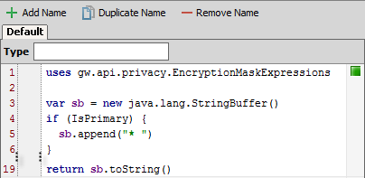
Entity Name editor: Return value pane
Add Name, Duplicate Name, and Remove Name buttons
Create, copy and delete entity name types
Type field defines entity name type
Default is empty string
Case sensitive
Gosu text editor
Use table variables
Specify the expression for the return value
Requires server restart to implement
Notes:
The return value pane defines a Gosu code expression that specifies the logic for the return value for a given entity name type.
For a given entity name file, you can define more than one entity name type. You can create your own entity name type with the Add Name and Duplicate Name buttons. Specify the name in the Type field. The value in the Type field is case sensitive. Remove an entity name type with the Remove Name command. Some entity name types are internally exposed and the Type field should not be edited nor the name itself deleted. Similarly, Default should not be modified or deleted. The Type field is always empty for the Default entity name type.
In the Gosu text editor, you can specify an expression that returns a string for the given entity name type. You can edit the Gosu code for the Default entity name type, internally exposed entity name types, as well as your own custom entity name types. In order to implement any change to an entity name type, you must restart the application.

Slide 11
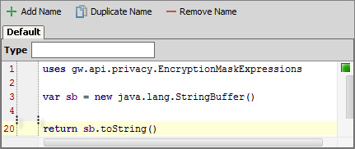
Entity Name editor: Return value pane
Specify the expression for the return value for the default entity name type
Gosu text editor
Import other classes if needed
Reference table variables in Gosu code
return statement with value required
Line 20: returns the value for the Default entity name type
Entity names types covered later in lesson
Notes:
The return value pane defines a Gosu code expression that specifies the logic for the return value for a given entity name type. In the Gosu text editor, you can specify an expression that returns a string for the given entity name type. You can edit the Gosu code for the Default entity name type, internally exposed entity name types, as well as your own custom entity name types. The Type field is always empty for the Default entity name type. In order to implement any change to an entity name type, you must restart the application.

Slide 12
Entity name files and entity name types
Create and configure entity name types
Reference entity name types

Slide 13
Steps to create an entity name type
Create a new entity name file
Define variables in the variable table
Define a return value expression for the default entity name type
[Optional] Define custom entity name types
Deploy entity name types
Create file
Define variables
Code Default return value
Create additional names
Restart Server
Code return values

Slide 14
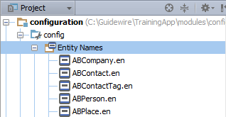
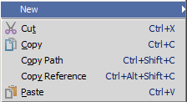

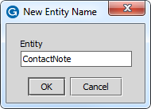
Step 1: Create a new entity name file
In Project View, select ...\config\Entity Names
Context menu → New → Entity Name
Entity Name dialog
Value needs to match the name of existing entity!
Studio will not allow you to create an entity name for a non-existent entity
Notes:
To create a new entity name:
Right-click Entity Names in Project View to open the context menu.
In the context menu, select New → Entity Name.
In the New Entity Name dialog, enter the name of an existing entity.
Click OK.

Slide 15

Step 2: Define the variables
Create, edit and delete variables
Variables use in Return value pane
Name column
Reference the entity property by name
Entity path column
Specify path to property using dot notation
Invalid paths will show as red text
ContactNote.BodyText
Notes:
To add a symbol, click the Add button. This creates a blank row in the symbol table. Specify values in the row as needed.
In the Entity Path cell, if you do not enter a valid path for the base entity, the cell displays in red. For example, if enter "ContactNote.Boddy", the cell becomes red because there is no field on ContactNote named "Boddy".

Slide 16
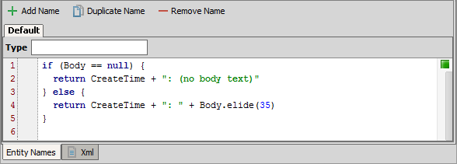
Step 3: Define a default return value
Must return a string value
If simply returning the value of a variable name, the return keyword is NOT required
Notes:
In the slide example above, the return value is the CreateTime field plus either: A) ": (no body text)" string (if the Body is null) or B) ": " string plus the first 35 characters of the Reason field plus "..." (if the Body is non-null).

Slide 17
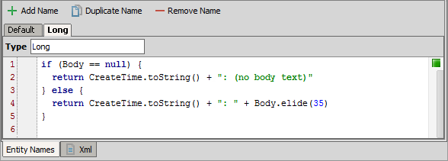
Step 4: [Optional] Define custom types
Add Name creates a new tab for the entity name type
Type field specifies the name of the entity name type
Return value expression must be a string
Use the same variables in the Variable table
Notes:
For a given entity name file, you can define more than one entity name type. You can create your own entity name type with the Add Name and Duplicate Name buttons. Specify the name in the Type field. The value in the Type field is case sensitive. Remove an entity name type with the Remove Name command. Some entity name types are internally exposed and the Type field should not be edited nor the name itself deleted. Similarly, Default should not be modified or deleted. The Type field is always empty for the Default entity name type.
You can create additional entity name types. Click Add Name. Enter a Type for the additional display name. In the Return Value pane, define a return value expression.
In the slide example, the CreateTime.toString() produces a long date time format. Long is the alternative reference to an entity name type.

Slide 18
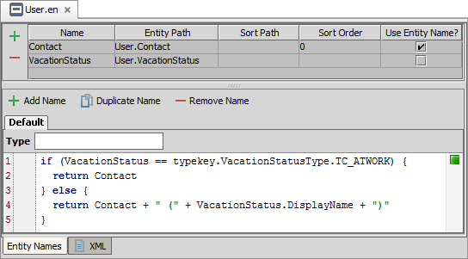
Foreign key variables
Contact variable references a foreign key entity path
Use Entity Name? check box indicates that the variable will use the default entity name type for the foreign key entity
Notes:
The Use Entity Name? check box indicates that there is a foreign key entity reference for a variable and that this reference needs to use the default entity name type definition for itself.
In the slide example, the Contact variable represents a foreign key to UserContact, a subtype entity of the Person entity. The Person entity implements the GlobalPersonName delegate entity. The shared delegate/interface allows multiple entities to share definitions of removable globalization fields associated with Persons. With the Use Entity Name? check box checked, the Contact variable uses the Person default entity name type as defined in the Person.en entity name file.

Slide 19
Typekey fields in entity names
Do not use the DisplayName property in the Entity Path for typekeys
For typekeys, use the DisplayName property in the Gosu expression so as to return the description
Notes:
In the slide example, the VacationStatus symbol does not have as its entity path User.VacationStatus.DisplayName.
Always reference the display name in the entity name code. There are several reasons for this. Specifying DisplayName in the entity path forces Gosu to do an implicit String coercion, whereas an explicit conversion in the code is considered a better approach. The symbol table is also used to determine the default sort value for the entity. By mapping a symbol to a display name, you can create unpredictable sorting situations.

Slide 20
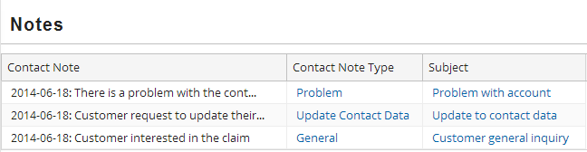
Datetime fields in entity names
When concatenating dates, short format is the default format in entity names
Use toString() to use long date format:
dow mon dd hh:mm:ss zzz yyyy
Use toStringWithFormat() to format date object
toStringWithFormat("MM/dd/YYYY")
Notes:
Date objects have no information about their format. When you call the toString() method, the method is a converts the Date object to a String of the form dow mon dd hh:mm:ss zzz yyyy. The Guidewire API offers several utility classes to assist with the formatting of the Data objects, including the gw.api.util.UltraFastDateFormat class.
If you return a datetime field in an entity name type without using concatenation, then Gosu uses the datetime's long format. If you return a datetime field in an entity name type and you use the concatenation operator, then the datetime's short format is used. If you want to concatenate a datetime field in an entity name type and get the datetime's long format, then convert the datetime variable o a string using the toString() method before concatenating the value.
When concatenating a string return value , Gosu creates multiple string objects. Gosu is interpreted by the Java Virtual Machine (JVM) and the Java language provides special support for the string concatenation operator (+) and for conversion of other objects to strings. Java implements string concatenation through the StringBuilder or StringBuffer class and the append method. The internal JVM optimizer decides which class to use. String conversions are implemented through the toString() method defined by Object and inherited by all classes in Java.

Slide 21
Step 4: Deploy entity names
Restart Server
bin command window
gwXX dev-stop
gwXX dev-start
Or, Guidewire Studio
Run → Stop
Run 'Server' or Debug 'Server'
Entity Name
Entity Name
Notes:
In Guidewire Studio, the newly created or modified default entity name type is available to reference immediately using the DisplayName property. However, the entity name is not available to the application server until the server is restarted.

Slide 22
Entity name files and entity name types
Create and configure entity name types
Reference entity name types

Slide 23
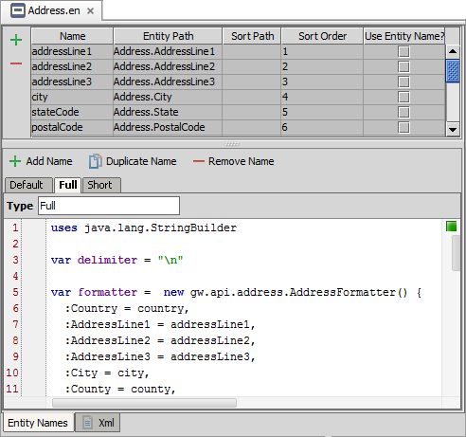
Internal entity names
Some entities have internal entity name types
Declared as entity name
Defined as entity property
Return value expression can be modified
Cannot modify the entity name type
Example:
Address.en
Full
var address = anABContact.PrimaryAddress
print(address.FullDisplayName)
Notes:
In the slide example, the Address.en entity name file shows three entity name type definitions: Default, Full, and Short. Short is a custom entity name type in TrainingApp. Of these three entity name types, Default and Full are internal names. Both are accessible by internal properties: DisplayName and FullDisplayName respectively. For more information about the internal entity name types for a given Guidewire application, consult documentation.
You cannot change a name for an internal name type (Default, Full), but you can change a name for a custom entity name type (Short).
For all three entity name types, you can modify the Gosu expression for the return value in the Return Value pane. In the slide example, the AddressFormatter() type is a special class for localizing address formats based on the user's region and locale. Displaying an address is very specific to the country, culture, and region. The entity name type definitions for an Address allow for complex application logic to display an address in the proper format as a single return value. To learn more about localization of names and addresses, consult the Globalization Guide in documentation.

Slide 24
Referencing the entity name type
1 uses gw.api.database.Query 2 var query = Query.make(Address).select()
3 for (address in query) {
4 var output : String
5 // Default, use entity.DisplayName
6 output += address.DisplayName
7 // Internal property for Full
8 output += address.FullDisplayName
9 // getDisplayName() is Default
10 output += address.getDisplayName()
11 // getDisplayName("Full") for Full
12 output += address.getDisplayName("Full")
13 // getDisplayName("Short") for Short. Short is custom
14 output += address.getDisplayName("Short")
15 print(output)
16 }
Default is DisplayName
getDisplayName("Name") for custom entity name type
Notes:
After creating a new entity display name, you must restart the application server instance. To get a custom entity name, use entity.getDisplayName(“Name”). The Name is case sensitive.
In the slide example….
Line 2: queries all Address entities.
Line 3: iterates through the results of the query.
Line 3: declares and string variable for console output.
Line 6: returns the Default entity name type using the DisplayName property.
Line 8: shows an internal property for the Full entity name type using the FullDisplayName property for the Address entity name type.
Line 10: shows an alternative to the DisplayName property using the getDisplayName() function. To specify the Default entity name type, the method has no arguments.
Line 12: returns the Full entity name type using the getDisplayName() method. The entity type name is case sensitive.
Line 14: returns the Short entity name type using the getDisplayName() method. The entity type name is case sensitive.

Slide 25
Describe the role of entity names in Guidewire applications
Distinguish between the entity name file and entity name types
Create and modify entity names using the Entity Name editor
Reference entity name types

Slide 26
For an ABPerson object, name an example of when the object's entity name might appear in the user interface.
What property points to an object's default entity name type?
For which entities do you need to create an entity name file?
When is the return keyword not required for entity name?
What must you do to deploy new entity name types or changes to existing entity name types?
Notes:
Answers
1. Possible answers: a drop-down list that displays a list of ABPersons; an info bar widget with a value property set to the ABPerson's DisplayName.
2. DisplayName
3. Custom entities and other entities whose display names are referenced in the user interface bud do not already have entity names.
4. When the return value is just a variable value.
5. You must restart the server.

